Slide 1
Title
Question: Do Stricter Gun Laws Reduce Firearm Deaths?
Presenter: Fomba Kassoh
Date: October 13, 2024

Slide 2
Introduction
Title: Gun Laws and Firearm Deaths
Content: Examining how the strength of state gun laws correlates with firearm mortality rates.

Slide 3
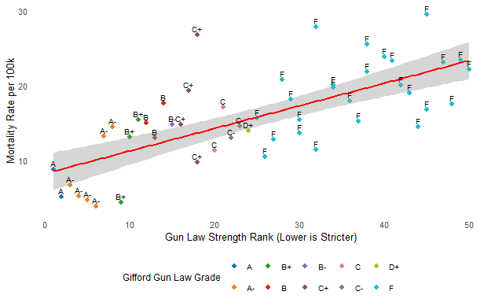
Stricter Gun Laws = Fewer Deaths
Weaker gun laws (F grades) are associated with higher firearm deaths, suggesting that less regulation may contribute to increased mortality.

Slide 4
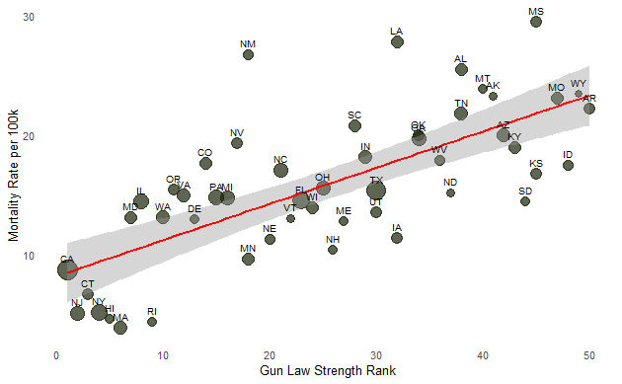
Large States with Stricter Gun Laws have Lower Firearm Mortality, reinforcing the relationship between regulation and outcomes.
Lower is Stricter

Slide 5
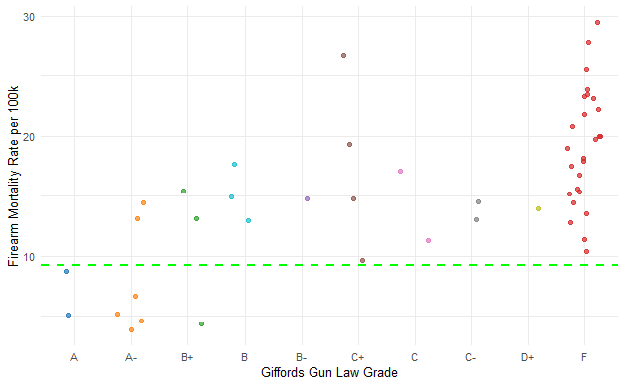
Gun Law Strength and Firearm Mortality
Stricter laws (A, A-) align with lower death rates, while lenient laws (F) align with higher death rates, reinforcing the central idea.

Slide 6
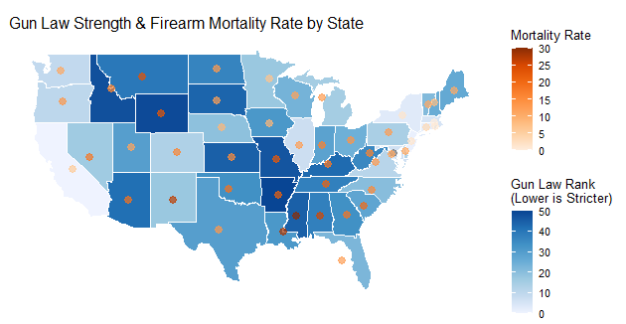
Stricter Gun Laws Reduced Firearm Gun Deaths
States with stricter gun laws tend to have lower firearm mortality rates.
Conversely, states with weaker gun laws show higher mortality rates

Slide 7
Summary
Key Insights
Stronger laws = lower mortality.
Weaker laws = higher mortality.
Some exceptions exist.

Slide 8
Conclusion
Stricter gun laws do appear to reduce firearm deaths, but other factors like enforcement and cultural differences also play a role in these trends.

